Slide 1
Retention & Turnover
Session 9/10

Slide 2
Session Outline
What is turnover?
Turnover in the UK
Measuring turnover
Should we care about turnover?
Why people leave?
Why people stay?

Slide 3
Employee Turnover
It’s the rate at which people leave the organization
Voluntary (e.g. people decide to leave because they want to retire or find a better job)
Involuntary (e.g. redundancies and dismissals)

Slide 4
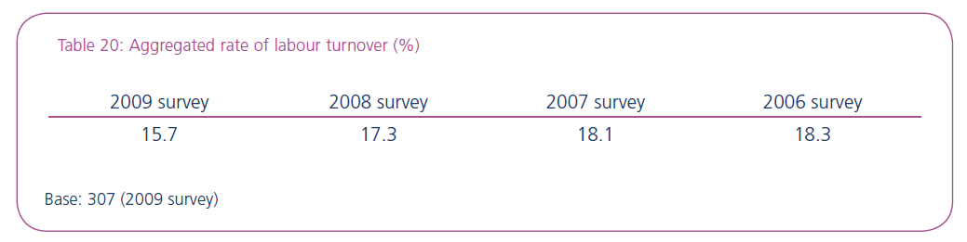
Some figures about turnover in the UK
Source: CIPD, 2009

Slide 5
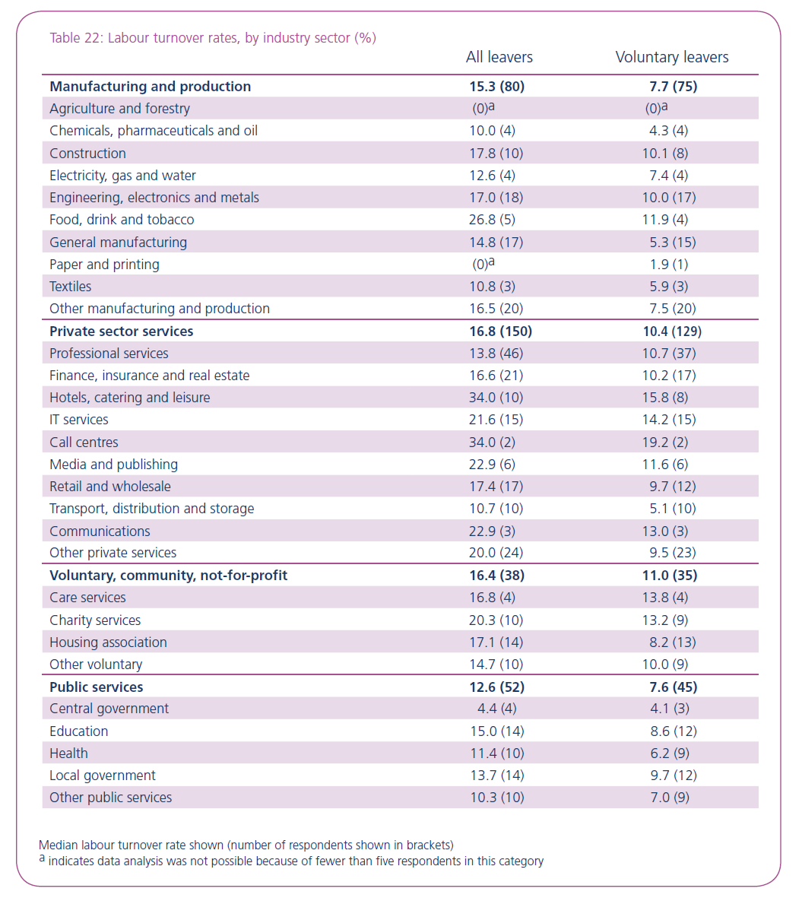
Source: CIPD, 2009

Slide 6
Some figures about turnover in the UK

Slide 7
Measuring Turnover
Employee turnover index
No. leavers in 1 year × 100
Average No. employees in 1 year
It’s a simple measure
Potentially misleading (who is leaving? From which departments/units?)
You may calculate the turnover index for business units; occupational categories, etc.

Slide 8
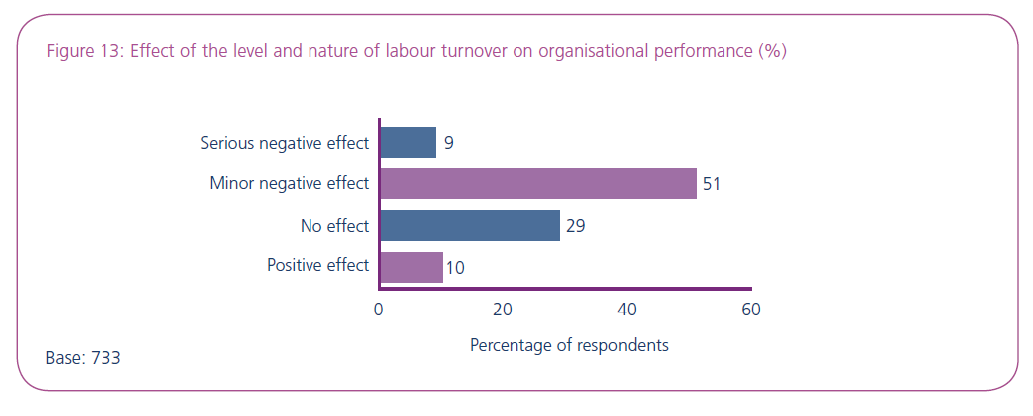
Should managing turnover be a priority for HR Managers?
Source: CIPD, 2009

Slide 9
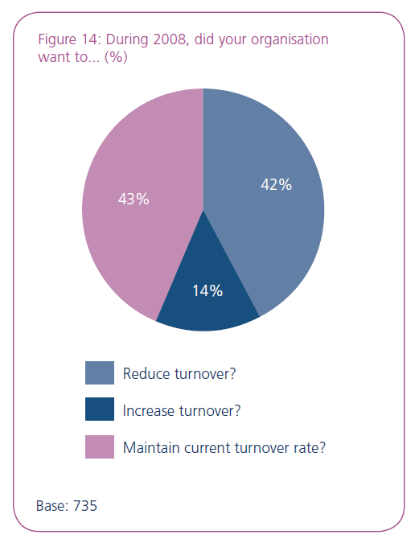
Should managing Turnover be a priority for HR Managers?
Source: CIPD, 2009

Slide 10


Thesis 1: Turnover is functional and has a minor impact on performance
1. There are many high turnover organizations wich are highly profitable
Business of numbers

Slide 11
Thesis 1: Turnover is functional and has a minor impact on performance
2. There are plenty of examples of high retention organizations offering poor service (e.g. some public sector organizations)

Slide 12

Thesis 1: Turnover is functional and has a minor impact on performance
3. Turnover stimulates the inflow of new ideas to the organization
4. High turnover facilitates control over your wage bill

Slide 13
Thesis 2: Turnover is dysfunctional and
has a detrimental impact on performance
1. Turnover is expensive
Recruitment and selection costs;
Induction costs;
Training costs;
Loss of productivity costs;
etc.

Slide 14
Thesis 2: Turnover is dysfunctional and
has a detrimental impact on performance
2. Turnover results in a loss of human capital
Skills need to be replaced. Are they widely available in the market?
Are people leaving for your competitors?

Slide 15
Thesis 2: Turnover is dysfunctional and
has a detrimental impact on performance
3. High turnover results in increasing work pressure for those who remain
4. High turnover rates reflect negatively on the company’s reputation with potential future employees and customers

Slide 16
Reconciling both thesis
Very high turnover is dysfunctional but some turnover is needed
What is considered an acceptable turnover rate depends on:
Sector (so benchmark)
Job category
Cost of replacing leavers
Costs of training new employees
Availability of skills in the labour market

Slide 17
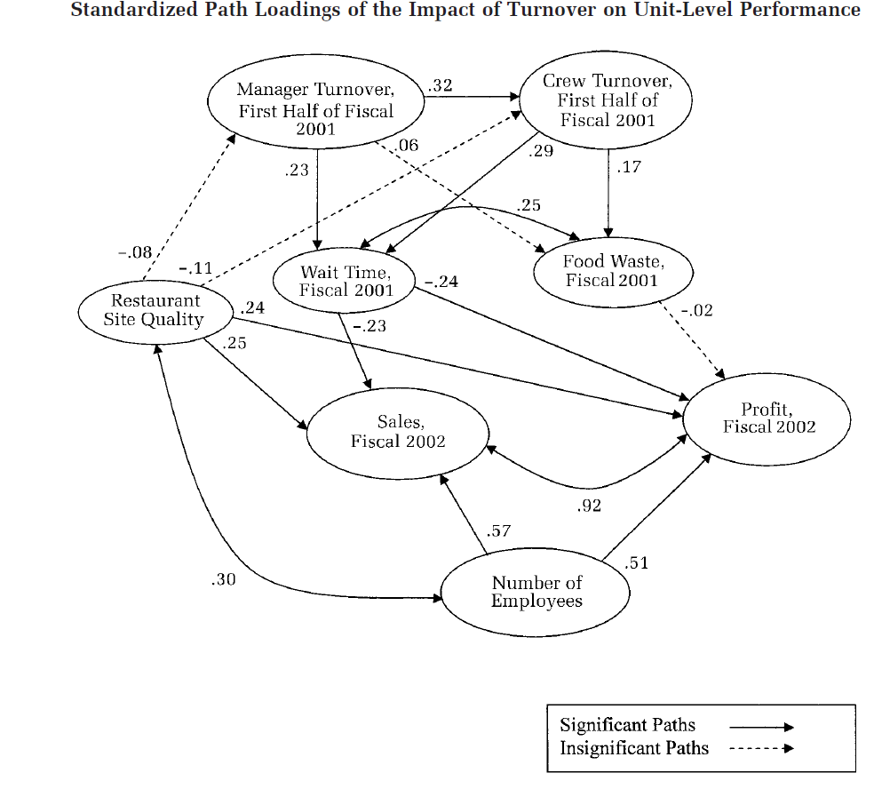
The evidence provides stronger support for the retention thesis
Kacmar et al 2006.

Slide 18
Why do people leave?
Pull Factors
Push Factors
Unavoidable turnover
Involuntary turnover

Slide 19

Why do people leave?
Pull Factors
Better Pay
Better career opportunities
Better work-life balance
So what can we do to improve retention?
Review rewards policy (Paying enough?; Types of rewards used?)
Review recruitment and selection policies (Hiring the right people?)
Review training and development policies
Etc...

Slide 20

Why do people leave?
Push Factors
Dissatisfaction with
company culture,
policies or practices
So what can we do to improve retention?
Review rewards policy (Paying enough?; Types of rewards used?)
Review recruitment and selection policies (Hiring the right people?)
Review training and development policies

Slide 21
Why do people leave?
Unavoidable turnover
Retirement
illness

Slide 22

Why do people leave?
Involuntary turnover
Redundancies
Dismissals
Contract termination
So what can we do to improve retention?
Review recruitment and selection policies (Hiring the right people?)
Review training and development policies
(Trying to prevent the situation!)

Slide 23
Why do people leave?
Why do people stay?
Why do people leave their jobs?

Slide 24
Diagnosing Turnover
Exit Interviews/Surveys
Ideally done right after the employee communicates she is leaving
Ideally conducted by HR or external interviewer
Information needs to be treated in a systematic way and used to inform HR policies
How useful are Exit interviews?
Are people honest?
Do people tend avoid to conflict by presenting socially acceptable reasons for leaving (e.g. better pay or family circumstances)?
Or do they see this as an opportunity to get back at the organization or their supervisors?

Slide 25
Why do people stay?
On the job embeddedness
Job-fit
Job Sacrifice
Job links
Off the job embeddedness
Community fit
Community sacrifice
Community links
Mitchell. T., Holtom, B., Lee, T., Sablynski, C., & Erez, M. (2001). Why People Stay: Using Job Embeddedness to Predict Voluntary Turnover. Academy of Management Journal, 44(6): 1102-1121.

Slide 26
References
Huselid, M. A. (1995). The impact of human resource management practices on turnover, productivity, and corporate financial performance. Academy of management journal, 38(3), 635-672.
Hancock, J. I., Allen, D. G., Bosco, F. A., McDaniel, K. R., & Pierce, C. A. (2013). Meta-analytic review of employee turnover as a predictor of firm performance. Journal of Management, 39(3), 573-603.
Jiang, K., Liu, D., McKay, P. F., Lee, T. W., & Mitchell, T. R. (2012). When and how is job embeddedness predictive of turnover? A meta-analytic investigation. Journal of Applied Psychology, 97(5), 1077.
Kacmar KM, Andrews MC, Van Rooy DL, Steilberg RC, Cerrone S. (2006). Sure everyone can be replaced …but at what cost? Turnover as a predictor of unit-level performance. Academy of Management Journal, 49, 133-144
Mowday, R. T., Porter, L. W., & Steers, R. M. (2013). Employee—organization linkages: The psychology of commitment, absenteeism, and turnover. Academic Press.
William Lee, T., Burch, T. C., & Mitchell, T. R. (2014). The story of why we stay: A review of job embeddedness. Annu. Rev. Organ. Psychol. Organ. Behav., 1(1), 199-216.

